Slide 1

Week 2

Slide 2
What is Big O
The language and metrics we use to describe the efficiency of algorithms
Both an upper bound and a lower bound on the time it takes to run an algorithm

Slide 3
Linear Search Runtime Analysis
An algorithm can be described in three ways
Best Case: O(1), we run the search once, the first element is what we are looking for
Worst Case: O(n), we search through all the elements in a list, the last element is what we are looking for
Expected/Average Case: O(n/2)

Slide 4
Space Complexity
Parallel concept to time complexity
If we need to create an array of size n, then this requires O(n) space
If we need to create a two-dimensional array of size n by n, then this requires O(n^2) space

Slide 5
Drop the Constants
Big O only describes the rate of increase
An algorithm that might be described as O(2n) should be described as O(n)

Slide 6
Drop the Non-Dominant Terms
We know O(n^2 + n^2) should be described as O(n^2), so n in O(n^2 + n) is even less important
O(n^2 + n) should be described as O(n^2)

Slide 7
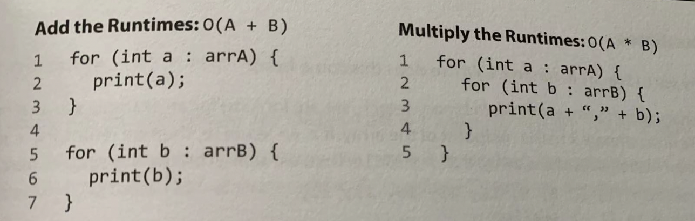
Multi-Part Algorithms: Add vs. Multiply

Slide 8
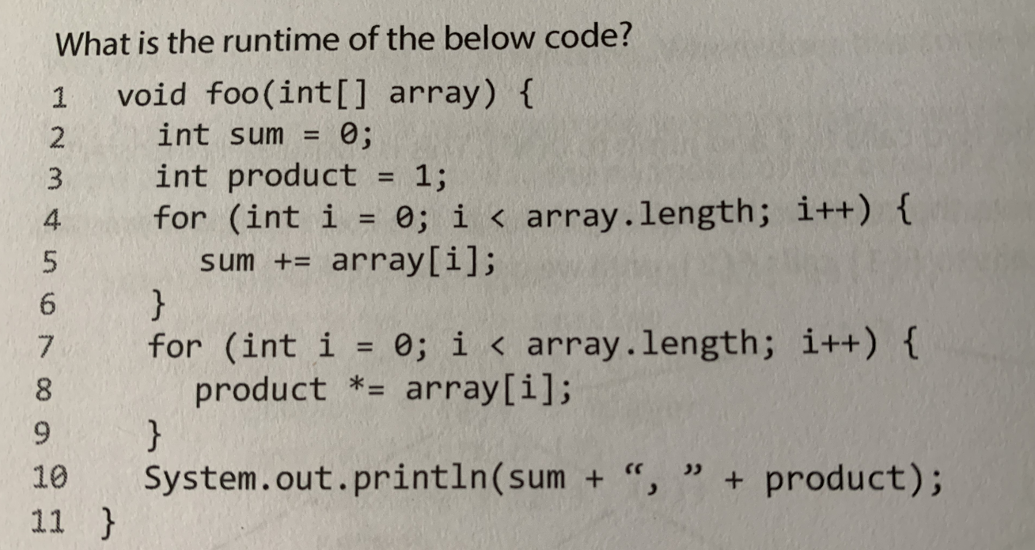

Slide 9
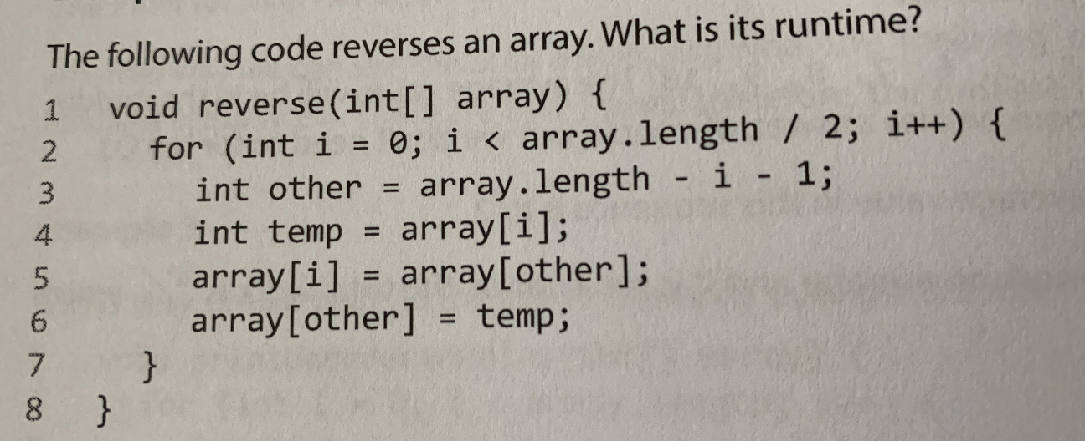

Slide 10
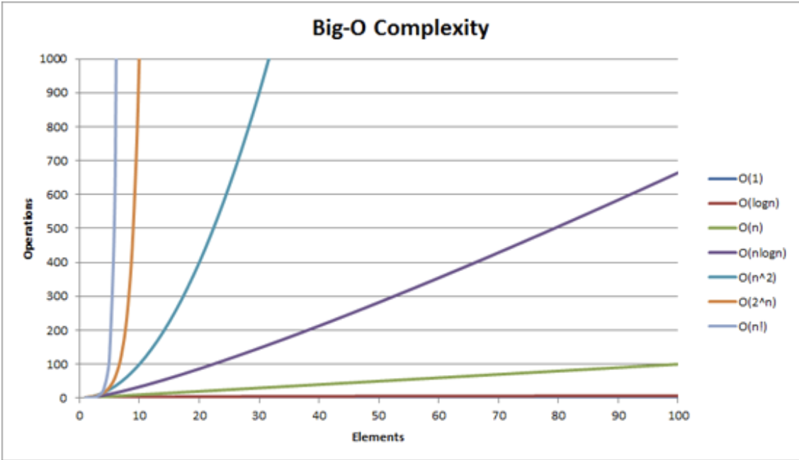

Slide 11
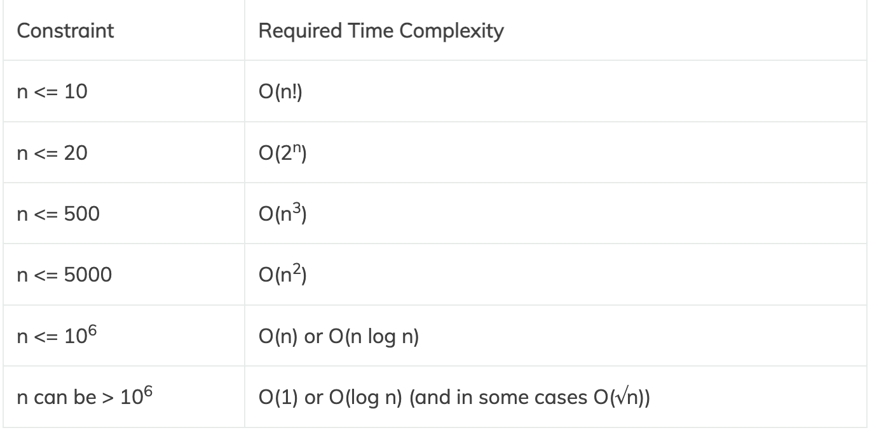

Slide 12
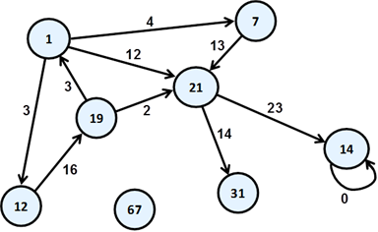
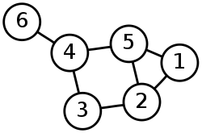
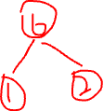
Graph

Slide 13
Graph
Consists of nodes(vertices) that are connected by edges(arcs)
When two nodes are connected by an edge, they are called neighbours
The degree of a node is the number of other nodes that it is connected to (the number of neighbours it has)

Slide 14
Graph
A loop is an edge that connects a node to itself
A path is a sequence of nodes that are connected by edges
A cycle is a closed path (a path that starts and ends at the same node, where no other node is visited more than once)
A tree is a connected graph with no cycle

Slide 15
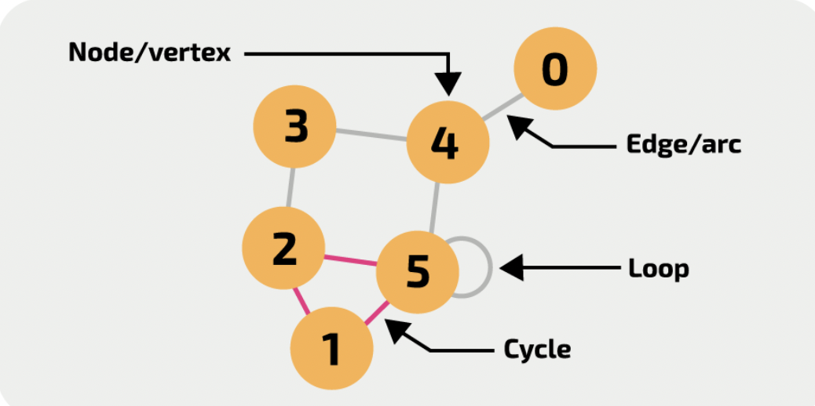

Slide 16
Adjacency Matrix
Used to represent a graph as a matrix of booleans
A finite graph can be represented in the form of a square matrix, where the boolean value of the matrix indicates if there is a direct path between two vertices
Matrix: a rectangular array or tables of numbers, symbols, or expressions, arranged in rows and columns

Slide 17
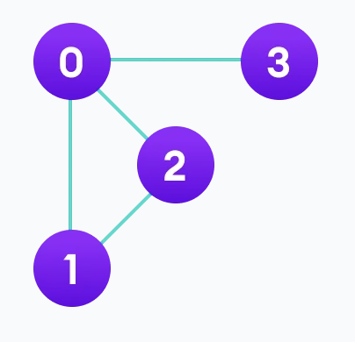
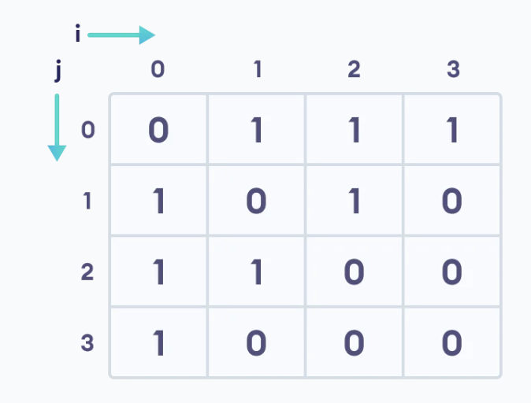

Slide 18
Adjacency List
Used to represent a graph as an array of linked lists
The index of the array represents a vertex and each element in its linked list represents the other vertices that form an edge with the vertex

Slide 19
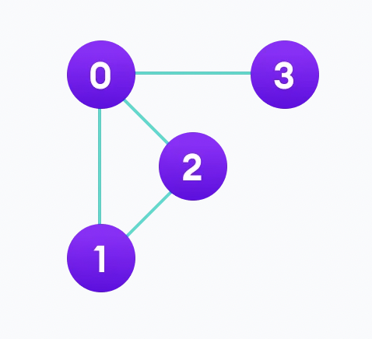
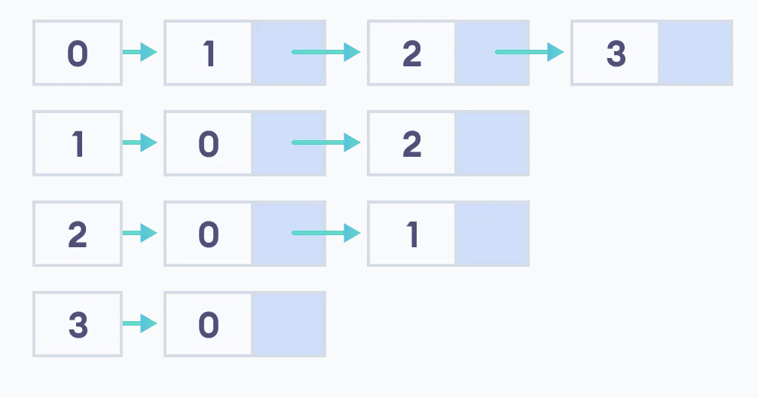

Slide 20
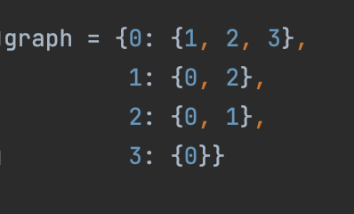

Slide 21
Depth-First Search / Depth First Traversal
A recursive algorithm for searching all the vertices of a graph or tree data structure
Traversal means visiting all the nodes of a graph

Slide 22
Depth-First Search / Depth First Traversal
Puts each vertex of the graph into two categories: visited & unvisited
The purpose of the algorithm is to mark each vertex as visited while avoiding cycles
Utilizes the stack data structure

Slide 23
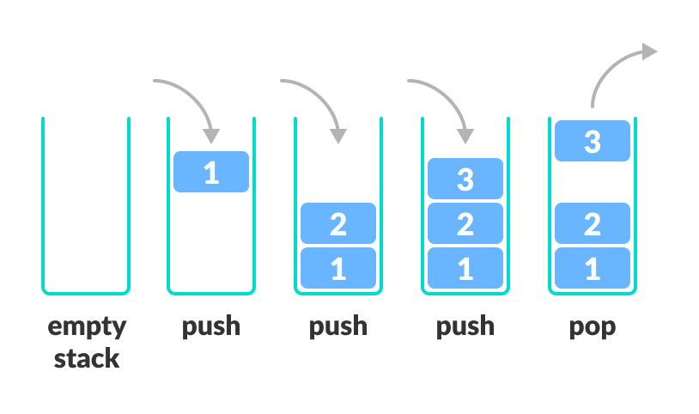
Stack
Follows the LIFO(Last-In-First-Out) principle and allows insertion and deletion operations from one end of the stack

Slide 24
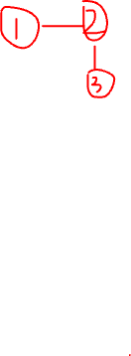
DFS Algorithm
Put any one of the graph’s vertices on top of a stack
Take the top item of the stack and add it to the visited list
Create a list of that vertex’s adjacent nodes (neighbours). Add the ones which are not in the visited list to the top of the stack
Keep repeating steps 2 and 3 until the stack is empty

Slide 25
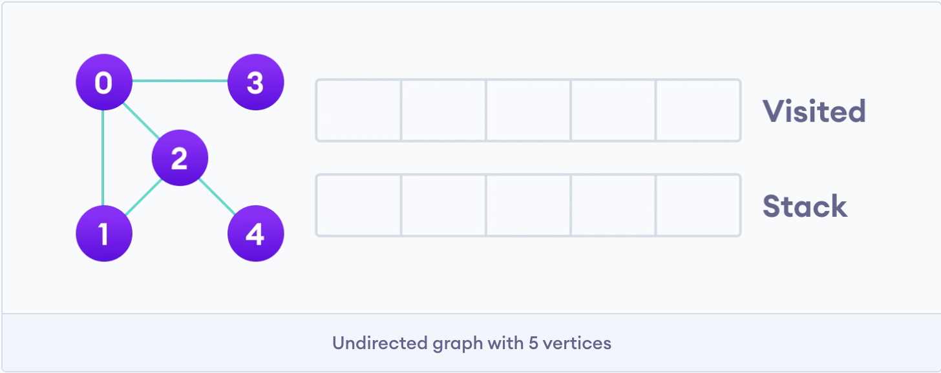

Slide 26
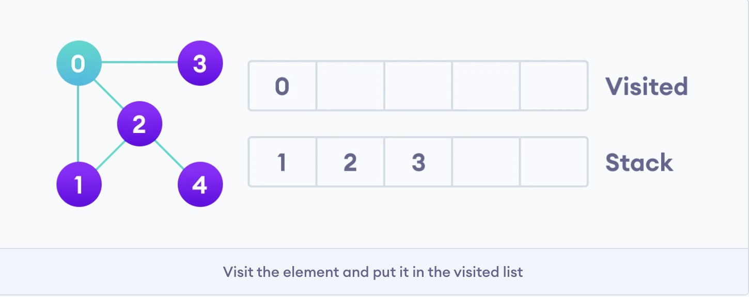

Slide 27
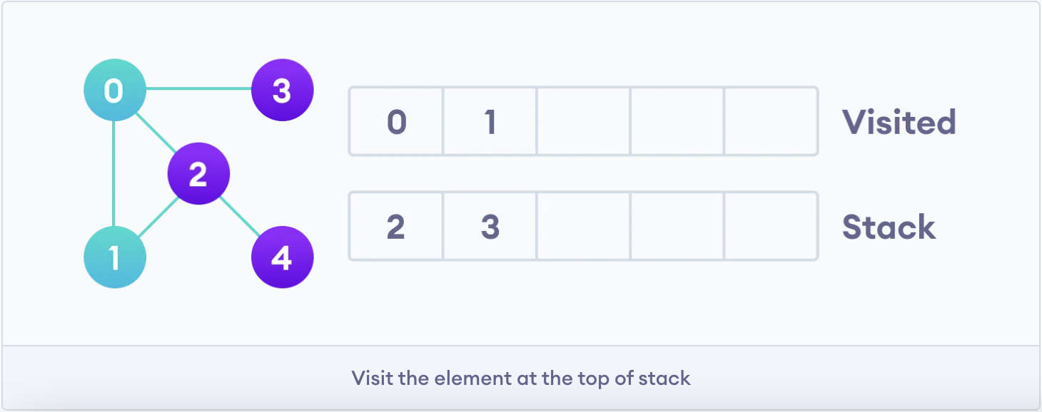

Slide 28
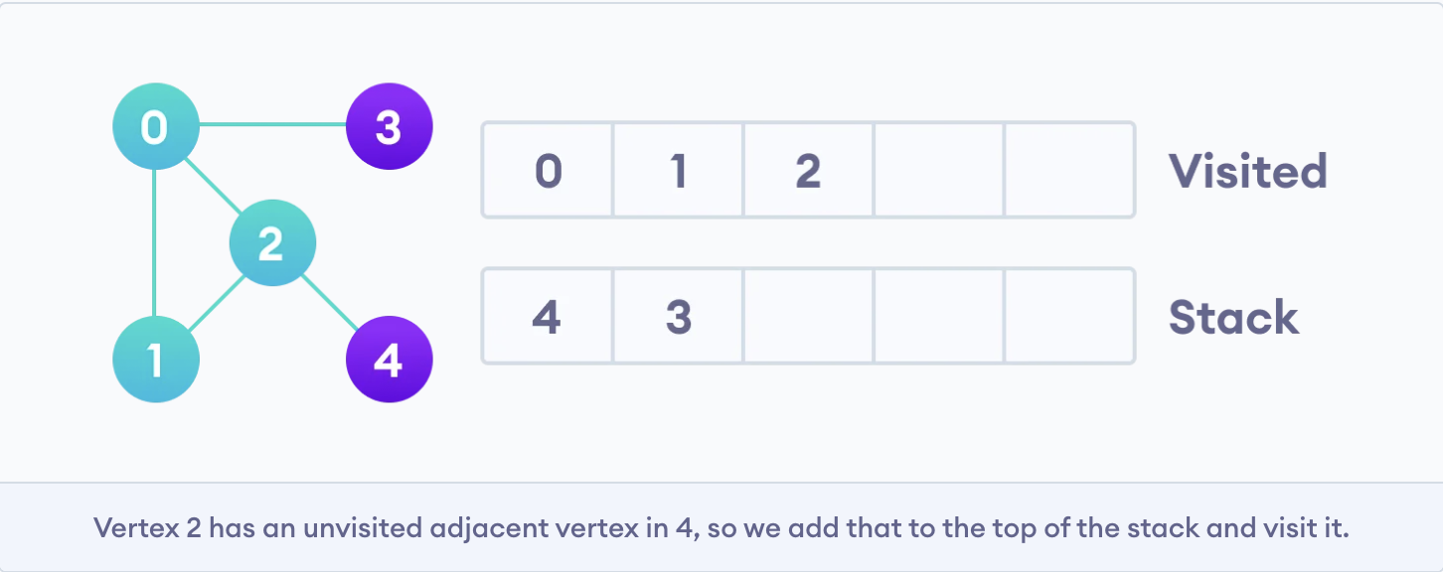

Slide 29
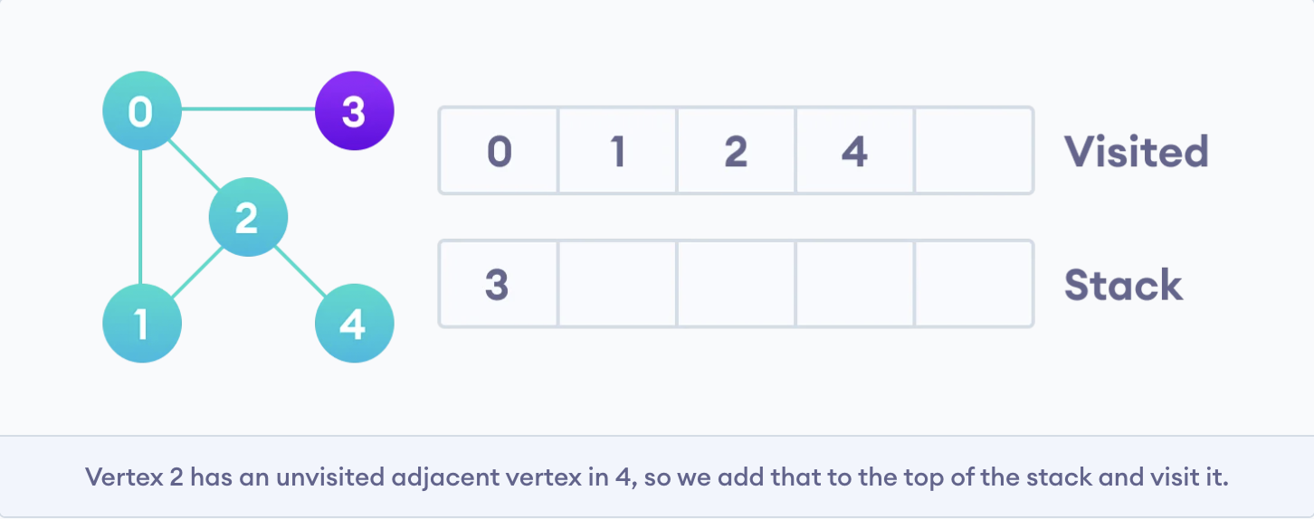

Slide 30
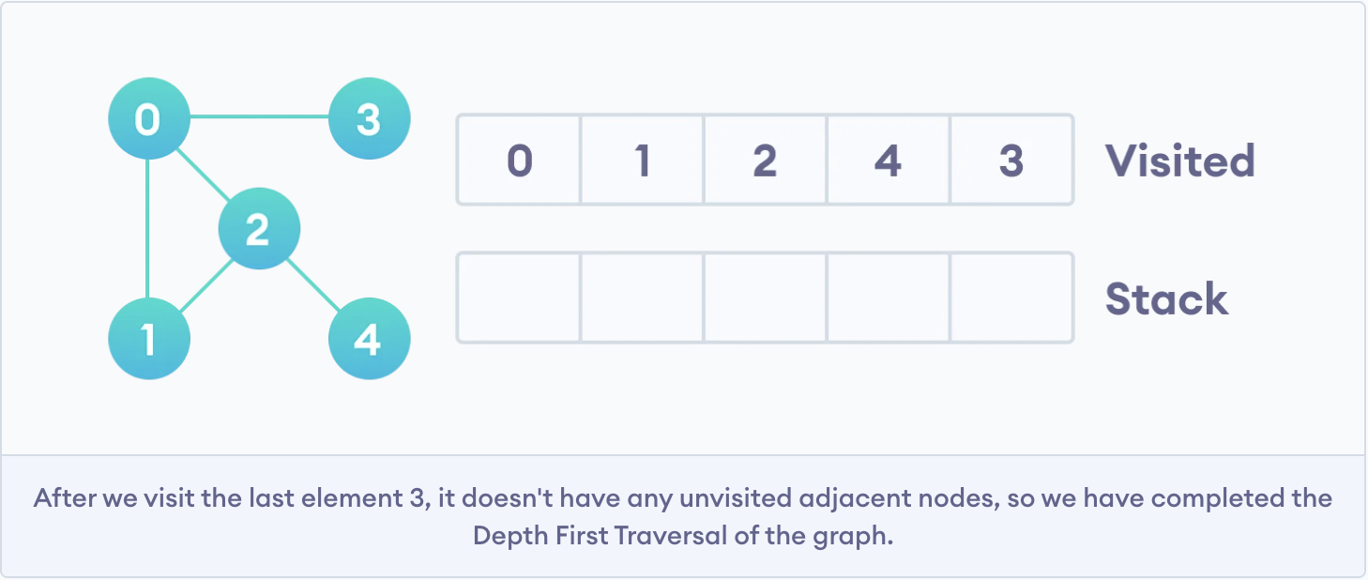

Slide 31
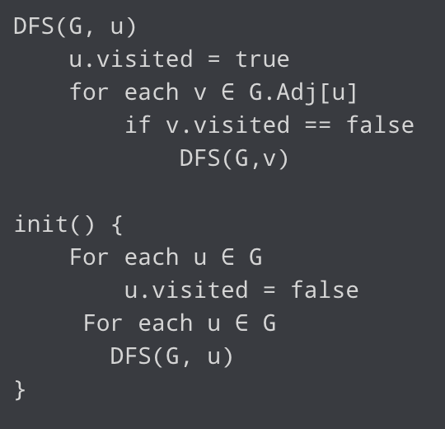
DFS Pseudocode

Slide 32
Time and Space Complexity
Time Complexity: O(V+E)
Space Complexity: O(V)

Slide 33
Breath First Search / Breath First Traversal
Put any one of the graph’s vertices on top of a queue
Take the front item of the queue and add it to the visited list
Create a list of that vertex’s adjacent nodes (neighbours). Add the ones which are not in the visited list to the back of the queue
Keep repeating steps 2 and 3 until the queue is empty

Slide 34
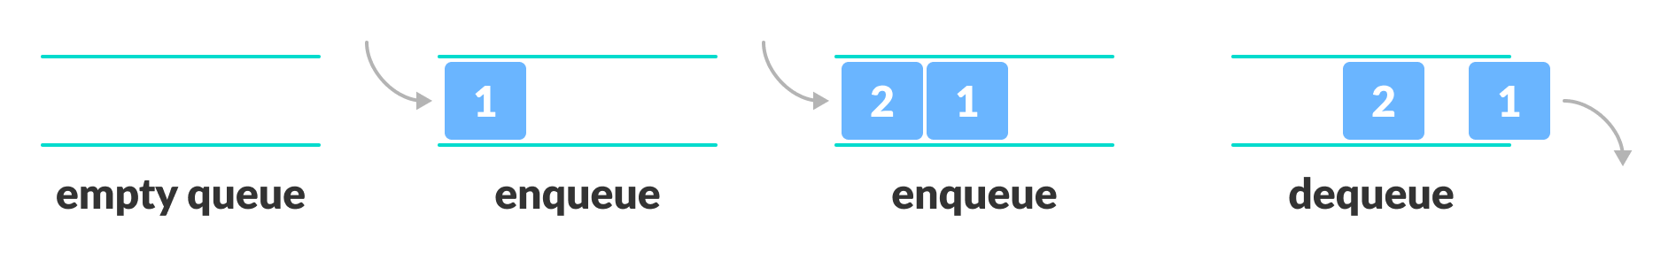
Queue
Open at both ends, one end for inserting data (enqueue), the other for removing data (dequeue)
Follows FIFO (First-In-First-Out), the data item stored first will be accessed first

Slide 35
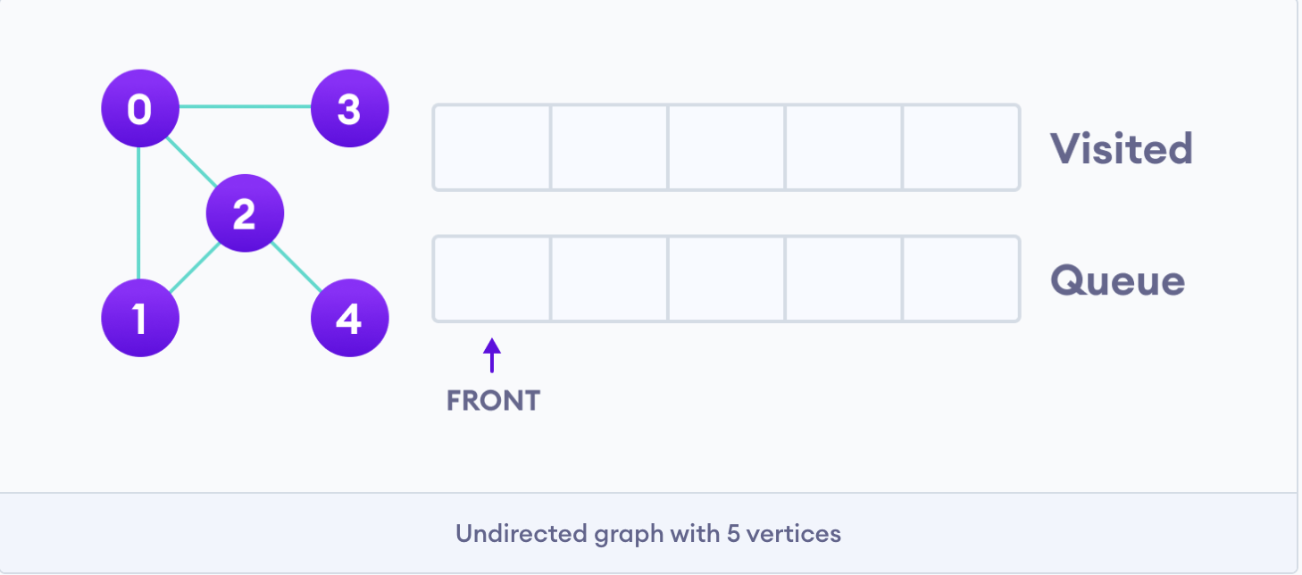

Slide 36
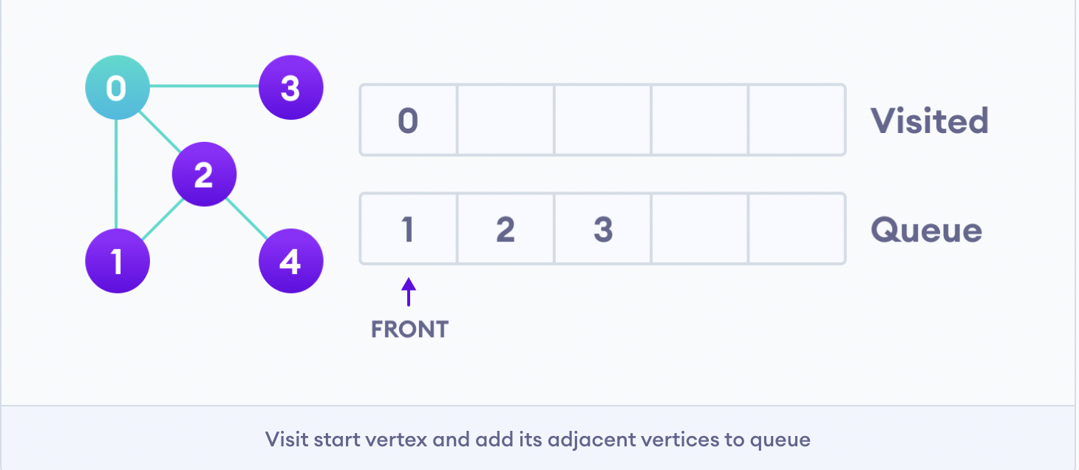

Slide 37
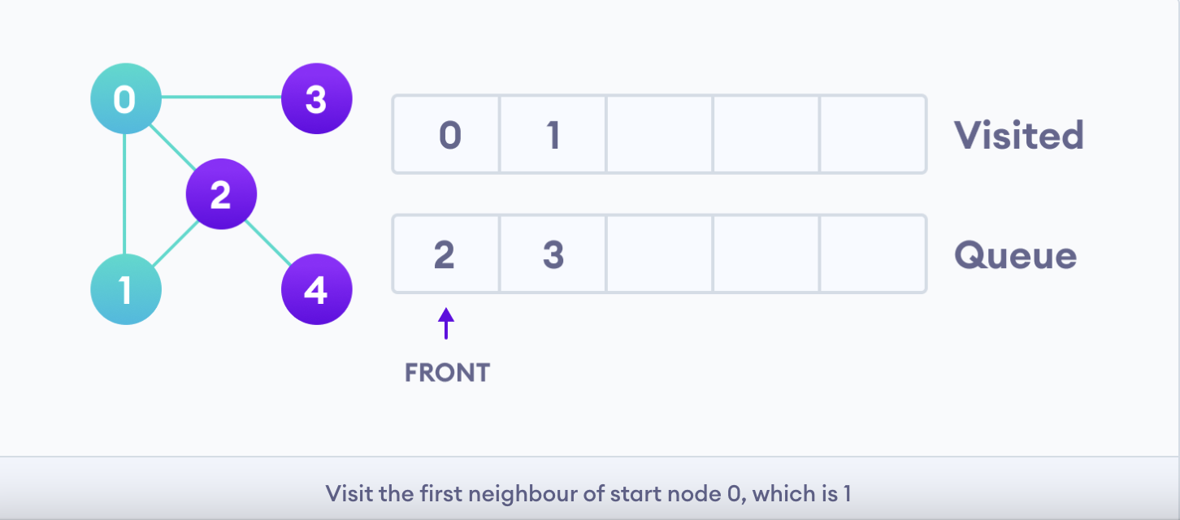

Slide 38
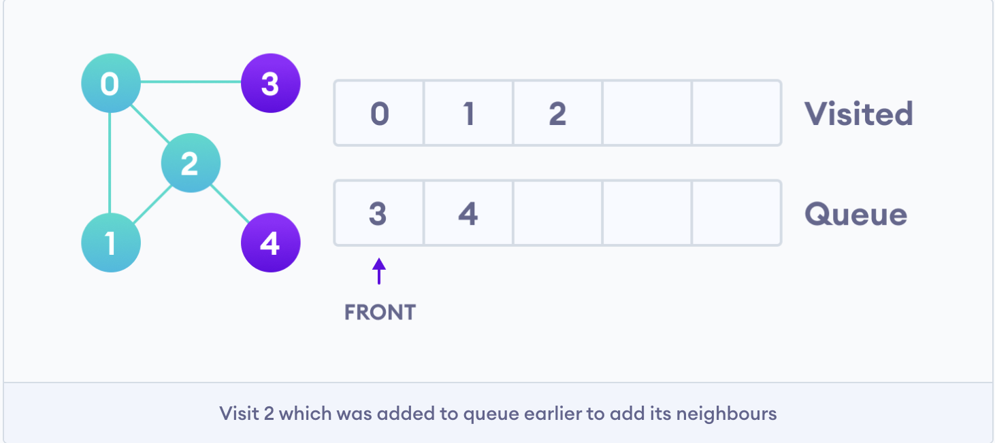

Slide 39
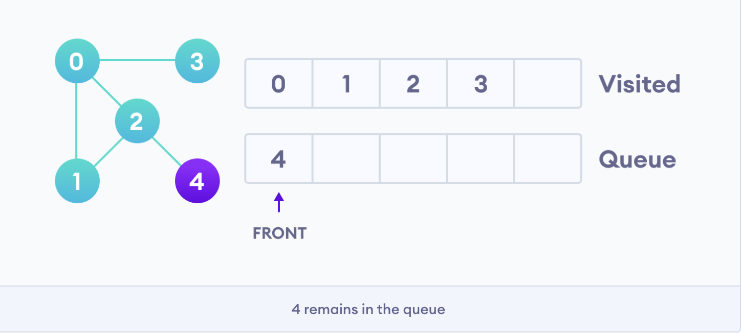

Slide 40
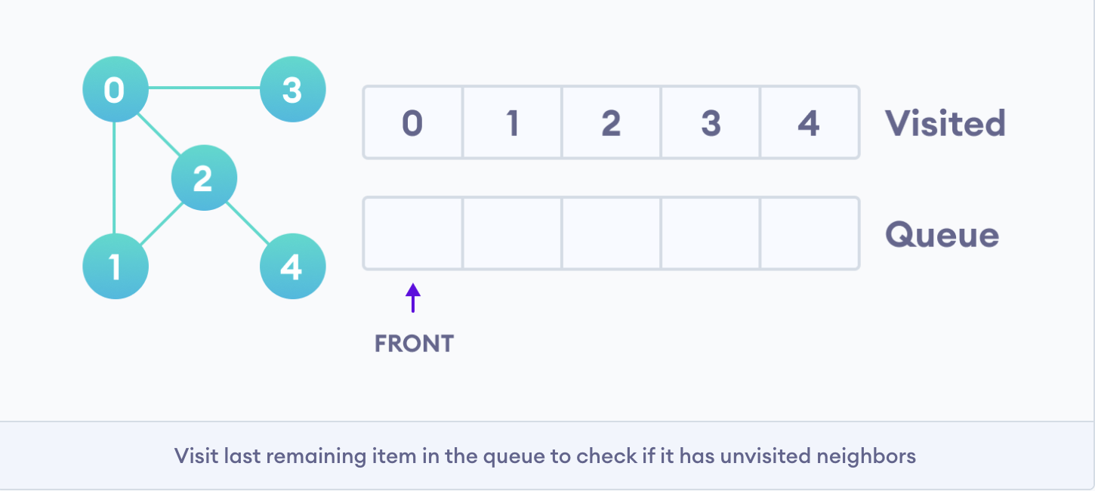

Slide 41
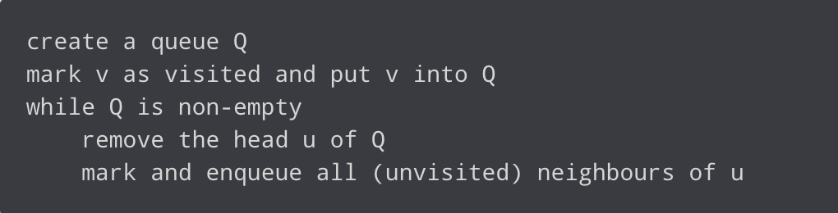
BFS Pseudocode

Slide 42
Time and Space Complexity
Time Complexity: O(V+E)
Space Complexity: O(V)

Slide 43
Homework:
https://dmoj.ca/problem/nccc1s4

Slide 44
Topological Sort
Takes a directed graph and returns an array of nodes where each node appears before all the nodes it points to
Directed graph: a set of nodes connected by edges, where edges have a direction associated with them

Slide 45
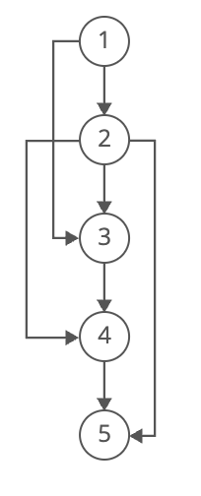
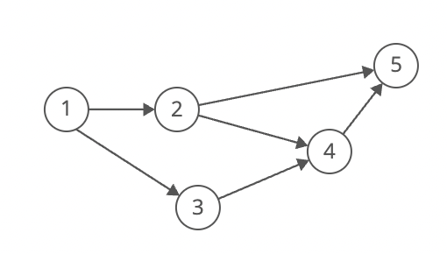
Topological Sort
Both [1, 2, 3, 4, 5] and [1, 3, 2, 4, 5] are valid topological ordering

Slide 46
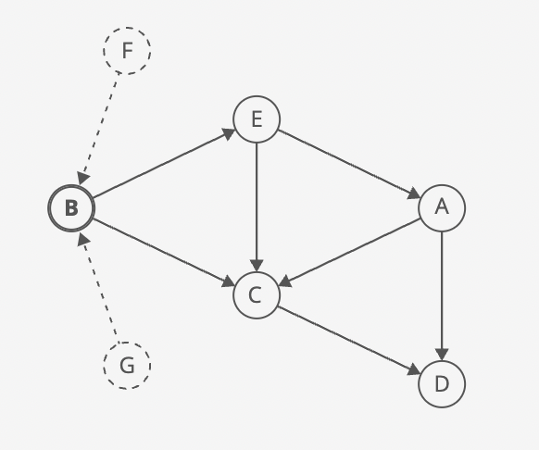
Topological Sort – First Node
Cannot have any incoming directed edges (indegree of 0)
If it had incoming directed edges, then the nodes pointing to it would have to come first

Slide 47
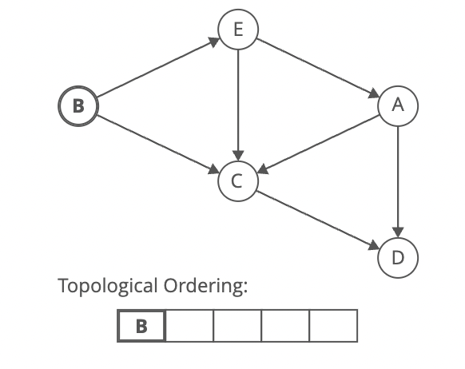

Slide 48
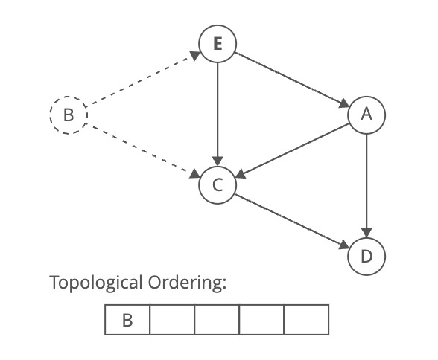
Repeat what we did for the first node…

Slide 49
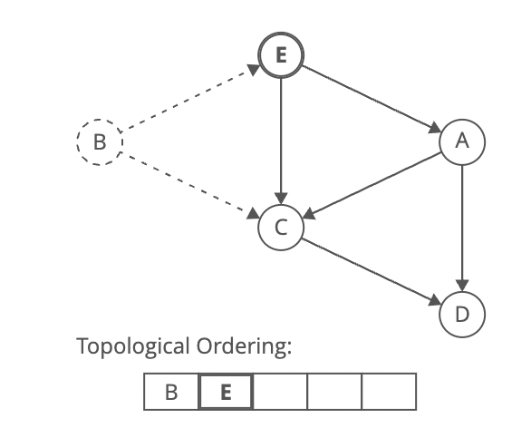

Slide 50
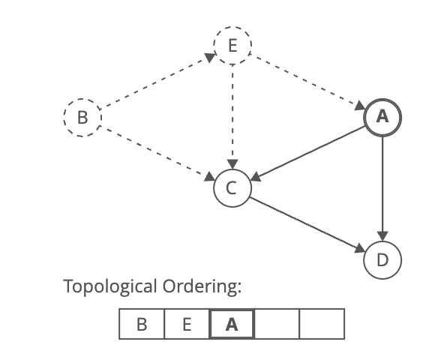

Slide 51
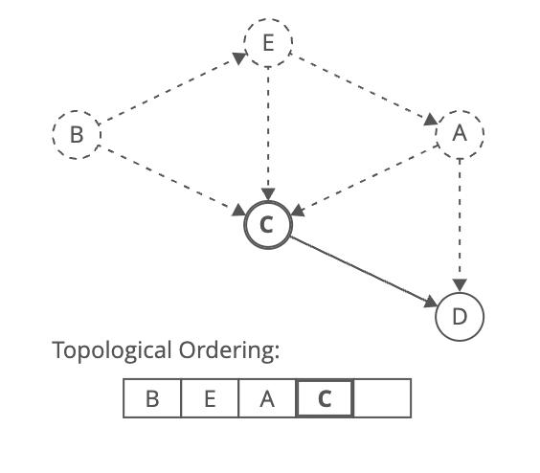

Slide 52
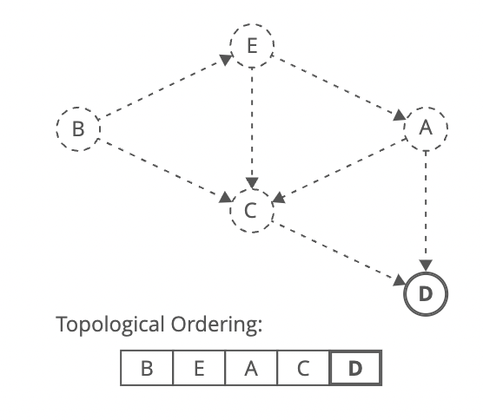

Slide 53
Strategy
Identify a node with no incoming edges
Add the node to the ordering
Remove it from the graph
Repeat step 1-3
One small tweak… We will use a map to track each node’s indegree. When we add a node to the topological ordering, we will decrement the indegree of that node’s neighbours

Slide 54
Time Complexity
Determine the indegrees: O(E)
Find nodes with no incoming edges: O(V)
Add nodes until we run out of nodes with no incoming edges: O(E) (decrement operation runs on all edges)
Comparing the size of the resulted topological ordering to check if the graph is cyclic: O(1)
Adding up individual run times, the overall time complexity is O(V+E)

Slide 55
Space Complexity
O(V) space required to store indegrees
O(V) space required to store nodes with indegree = 0
O(V) space required to store final array in topological order

Slide 56
Homework
https://dmoj.ca/problem/ccc06j4

